Slide 1

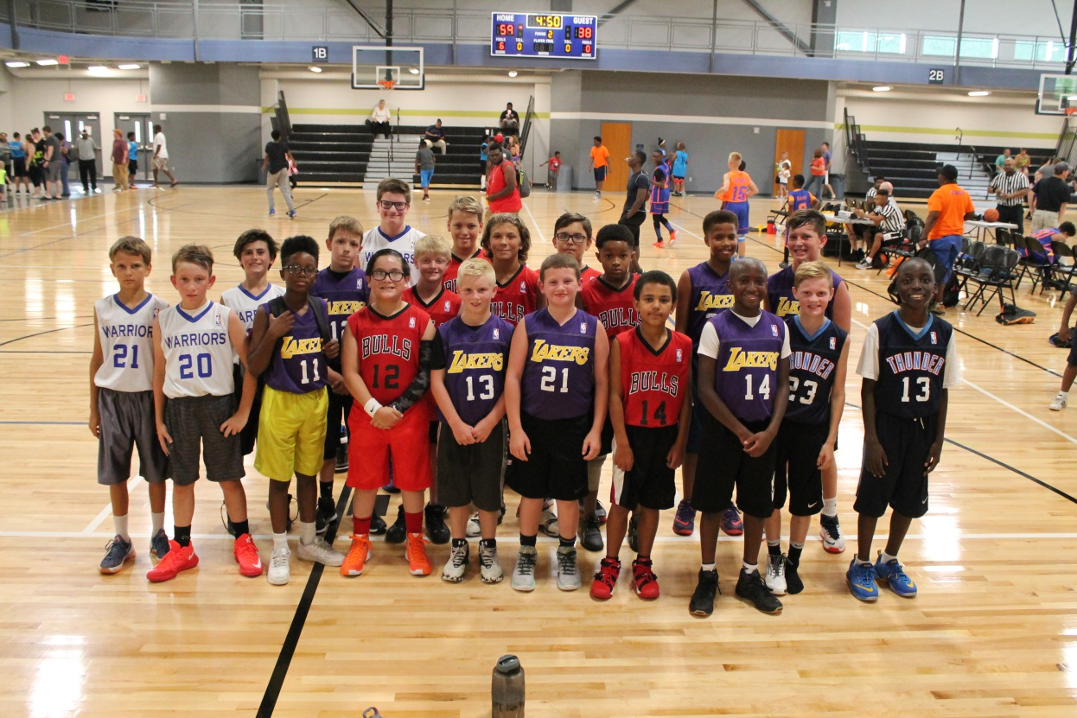
Coaches Meeting
Boys Jr. NBA Basketball
Sept. 26, 2024

Slide 2
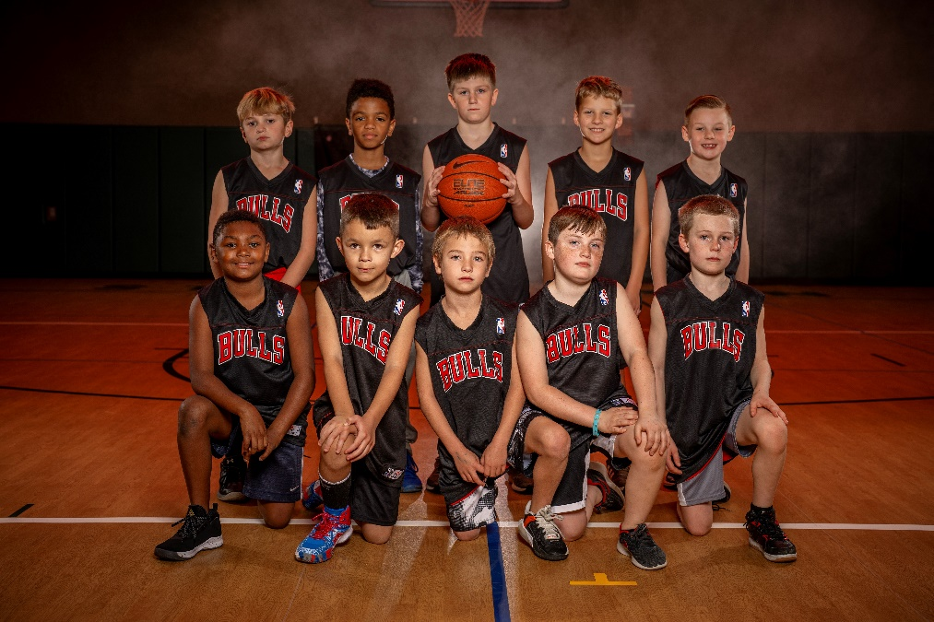
Housekeeping
Sign-In Sheet
Handouts
  Copy of PowerPoint Slides
  League Rules
  Indemnification form
  Fall/Winter Program Guide
1 hour meeting
Please hold your questions until the end

Slide 3

Thanks!
Thank you for coaching and volunteering your time to mentor young kids.
Great way to make a difference in our community.

Slide 4
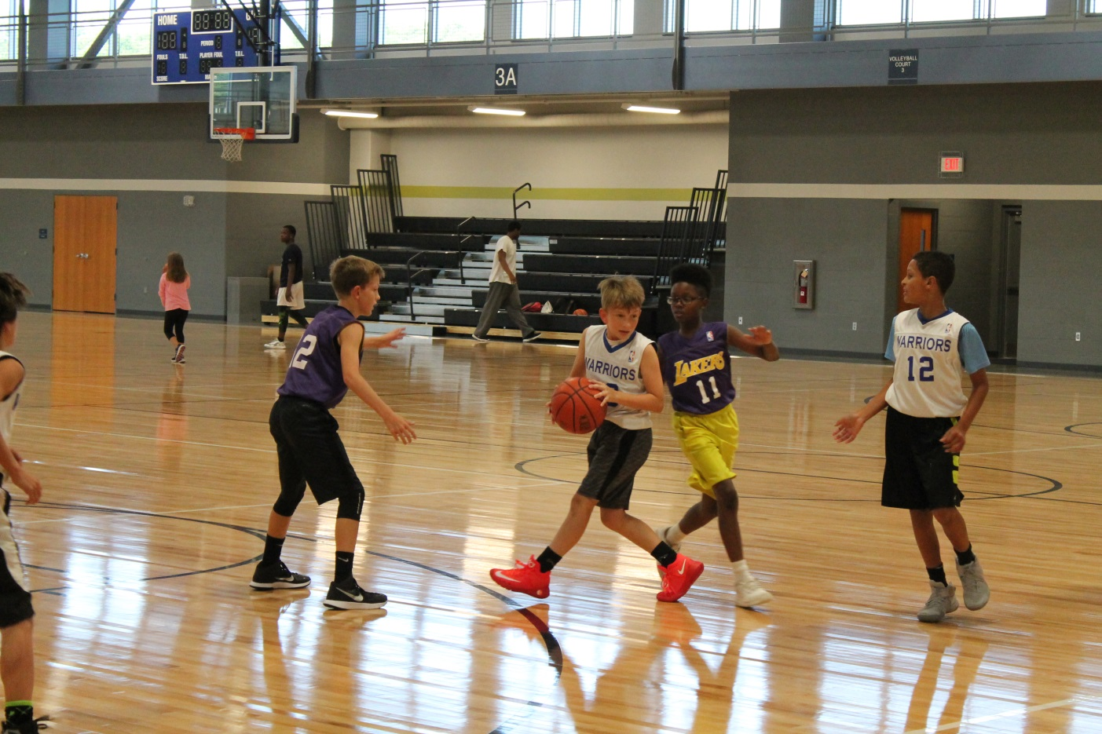
Our Goal
Provide a safe, fun, and enjoyable youth sports experience for the kids in our community.

Slide 5
League Formation
Grade | Night | # of Teams
Kindergarten | Mon. | 10
1st Grade | Tues. | 12
2nd Grade | Thur. | 10
3rd Grade | Thur. | 12
4th Grade | Thur. | 8
Total |  | 52

Slide 6
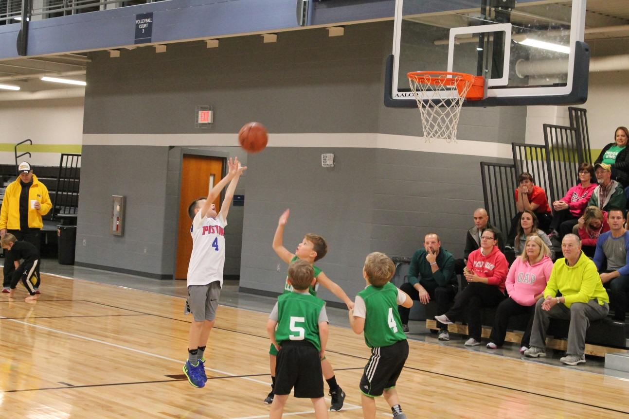

Slide 7
Team Names/Jerseys
Reversible NBA-replica jerseys will match your team name.
Jerseys will arrive about 1-2 weeks before your first game. I will email you when they are ready, so you can pick them up at The LINC.

Slide 8
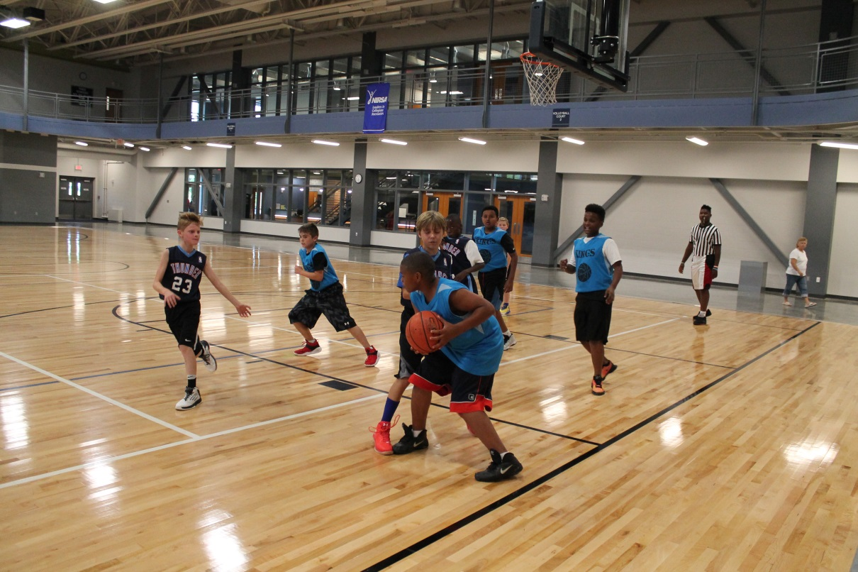

Slide 9
Background Checks
As part of the Coach’s Registration, we require all head coaches to submit an online criminal background check through Bchex, formerly Background Investigation Bureau (BIB).
Once you submit your info., it only takes about 1-2 days to be approved.

Slide 10
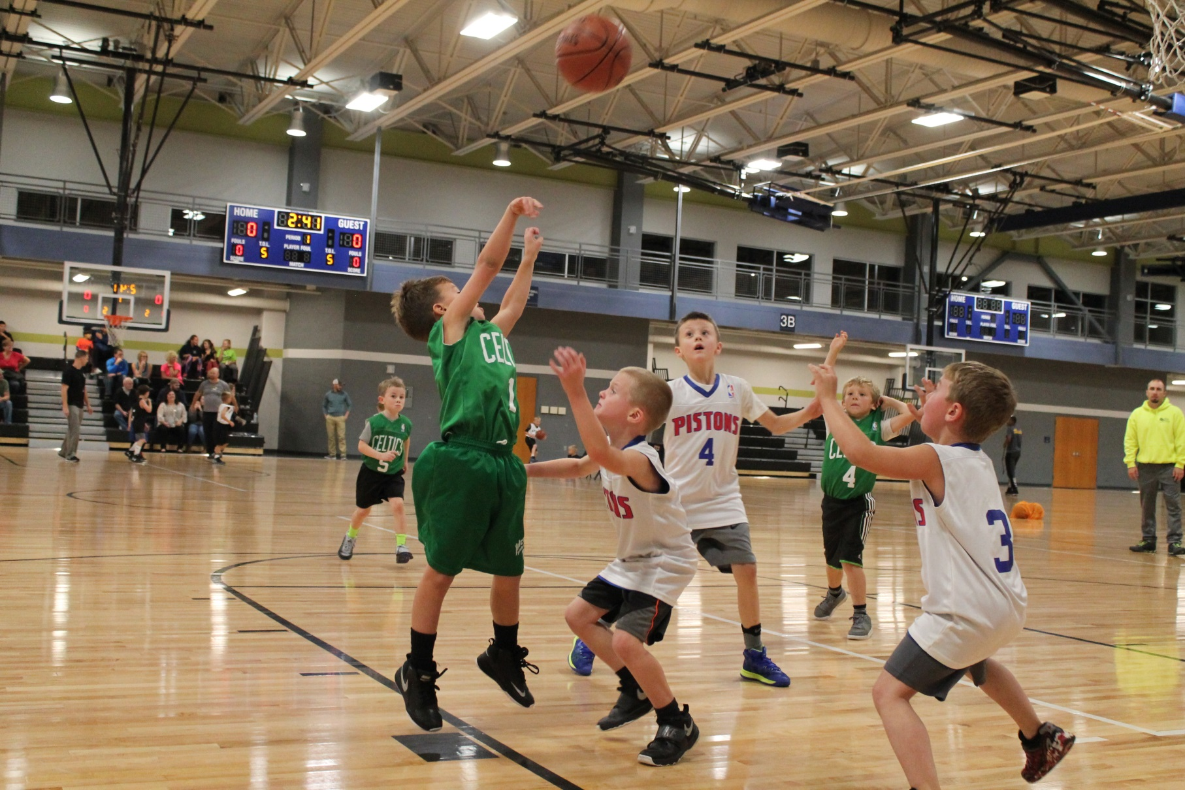

Slide 11
Team Rosters
On Mon. Sept. 23, coaches & parents received an automatic email from TeamSideline with a link to team rosters.
  Coaches can see the player’s names, the parents, and their contact information.
  Parents can only see the player’s names.
  I also sent a personal follow-up email with more info.

Slide 12
Team Rosters
Teams were formed by
  1. school
  2. reciprocal buddy requests
For grades K-1 (3 v. 3) we prefer rosters to be about 6 players.
For grades 2-4 (5 v. 5) we prefer rosters to be about 10 players.

Slide 13
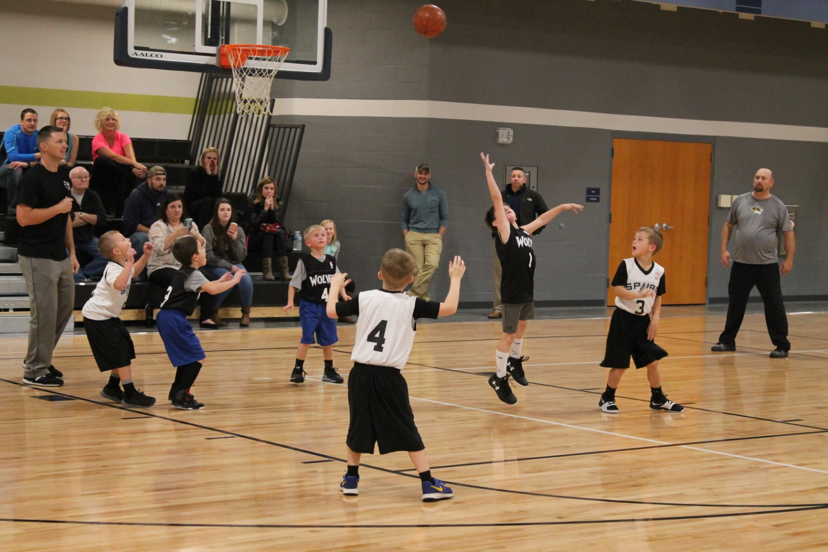

Slide 14
Communications
If you haven’t already, please contact your team parents ASAP to:
  introduce yourself
  let them know they are on your team
  inform them of any upcoming practices
  verify their contact information, etc.
There are also many free apps available for team communication like GroupMe, Team Snap & Remind.

Slide 15
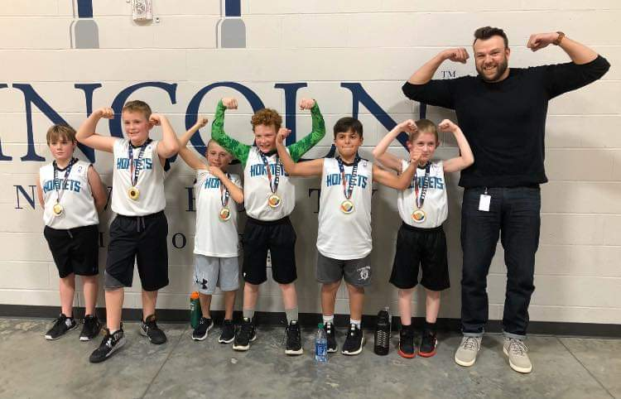
Parent Meeting
Parents can meet you, you can go over your expectations, goals, etc.
Quick meeting for 5-10 minutes before your first practice.
Important for parents to trust you.
Sample Goals:
  Have fun
  Get better
  Use good sportsmanship

Slide 16
Indemnification Forms:
Each parent on your team must fill out an Indemnification Form and return it to you.
On the league website.
Includes important info. like indemnification, treatment authorization, emergency contacts, & medical conditions.
Please keep until the season is over.
No need to submit these to me.

Slide 17
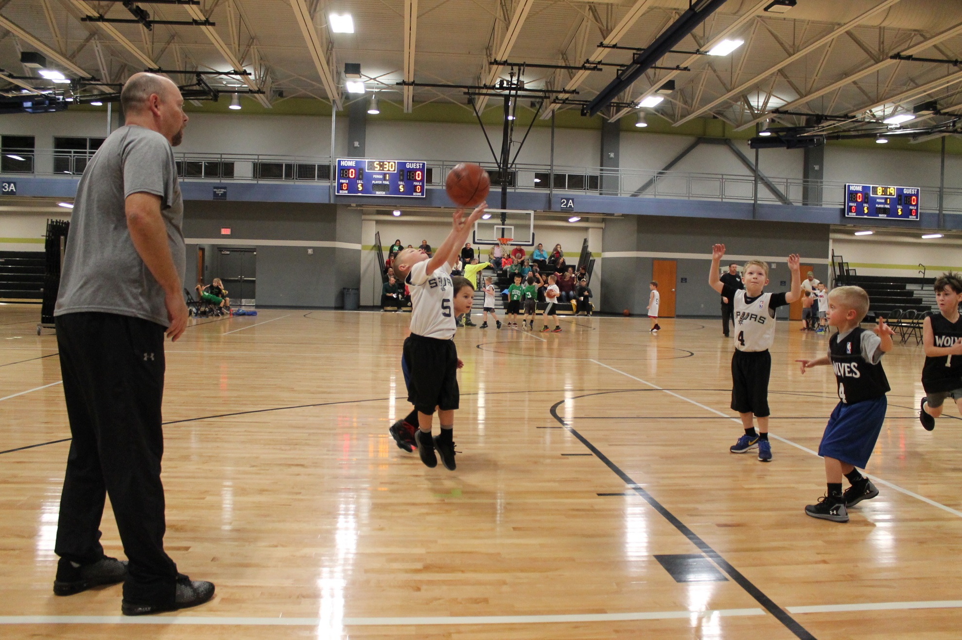

Slide 18
Certification Courses
For all Head Coaches through the National Alliance for Youth Sports (NAYS).
If you are a new coach to our programs, please take:
  Coaching Youth Sports (1 hour)
  Basic Youth Sports Safety & First Aid (45 minutes)
  Basketball U10 (30 minutes).
Free.
Online at your leisure, but please allow 2-3 hours.
NAYS will send you an automatic email with a link to the course(s) soon. I will send a follow-up.

Slide 19
Certification Courses
Benefits:
  $1,000,000 excess liability insurance coverage.
  access to a members-only section of the NAYS website, with coaching resources and additional free training opportunities.
    Resource Library, Skills and Drills section, Coaching Forum, etc.

Slide 20
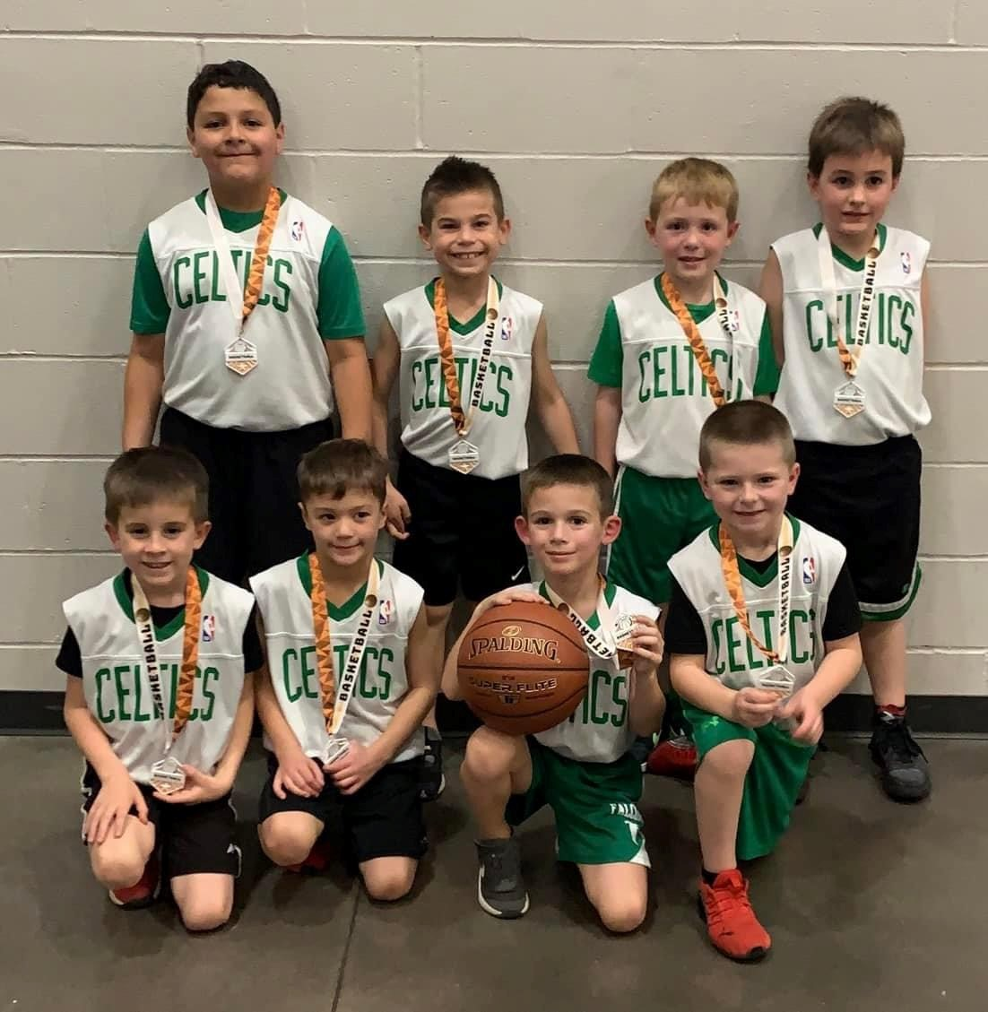
Assistant Coaches
Assistant Coaches are NOT required to complete the coach’s registration, submit the background check, or take the certification courses.

Slide 21
Game Schedules
6 games.
Once a week.
1st Games & Nights::
  K: Oct. 28, Mon.
  1^{st:} Oct. 29, Tues.
  2nd, 3rd, & 4th: Oct. 17, Thur.
@ The Linc.
Posted @ teamsideline.com/jeffersoncity a week or 2 before the season starts.
If any dates a majority of your team is not able to play, please let me know ASAP. I will try to accommodate, but no guarantees.

Slide 22
Game Times
Start at:
  K & 1st: 5:30, 6:15 & 7:00.
  2^{nd &} 3rd: 5:30, 6:15, 7:00, 7:45 & 8:30.
  4th: 6:15, 7:00, 7:45 & 8:30.
Games are about 40 minutes each
  Four 8-minute quarters, running clock, & 2-minute halftime.
Games are scheduled 45 minutes apart.

Slide 23
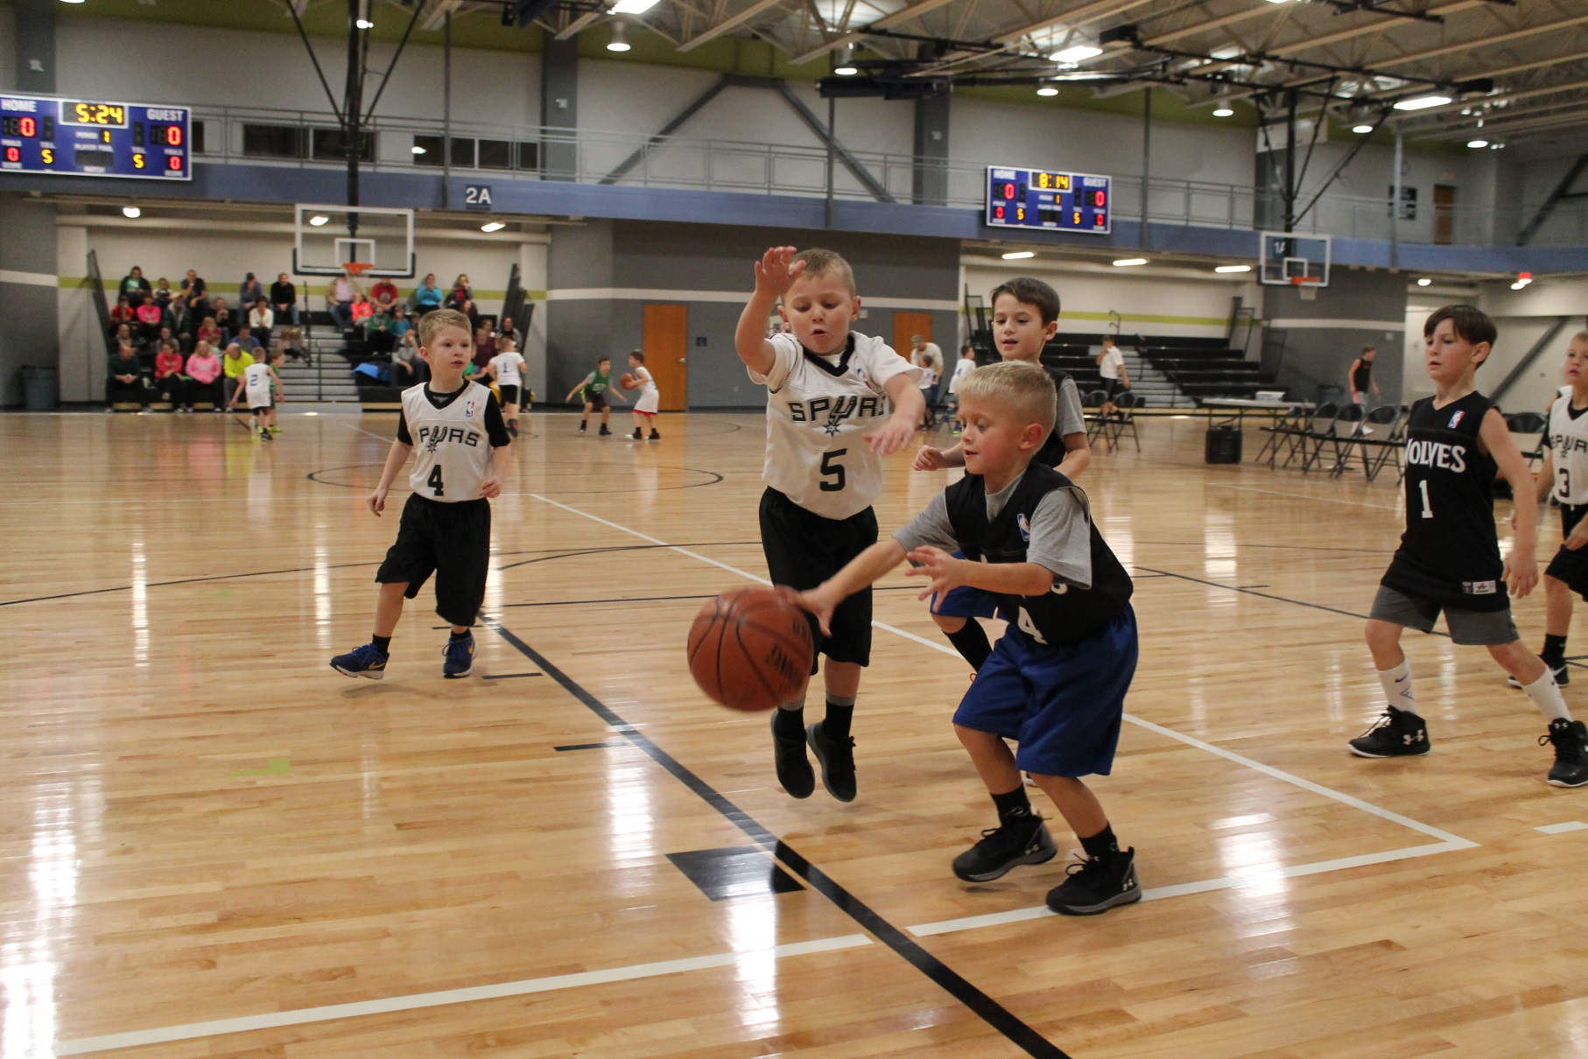

Slide 24
Cancelations
  Sign up to receive text alerts from JC Parks via TeamSideline.
  Posted at: jcparks.com/cancellations.
  Email sent to coaches & parents.
  We usually make a decision at 3 PM.
  Please do not contact us, it only slows down the process. We will notify you ASAP.

Slide 25
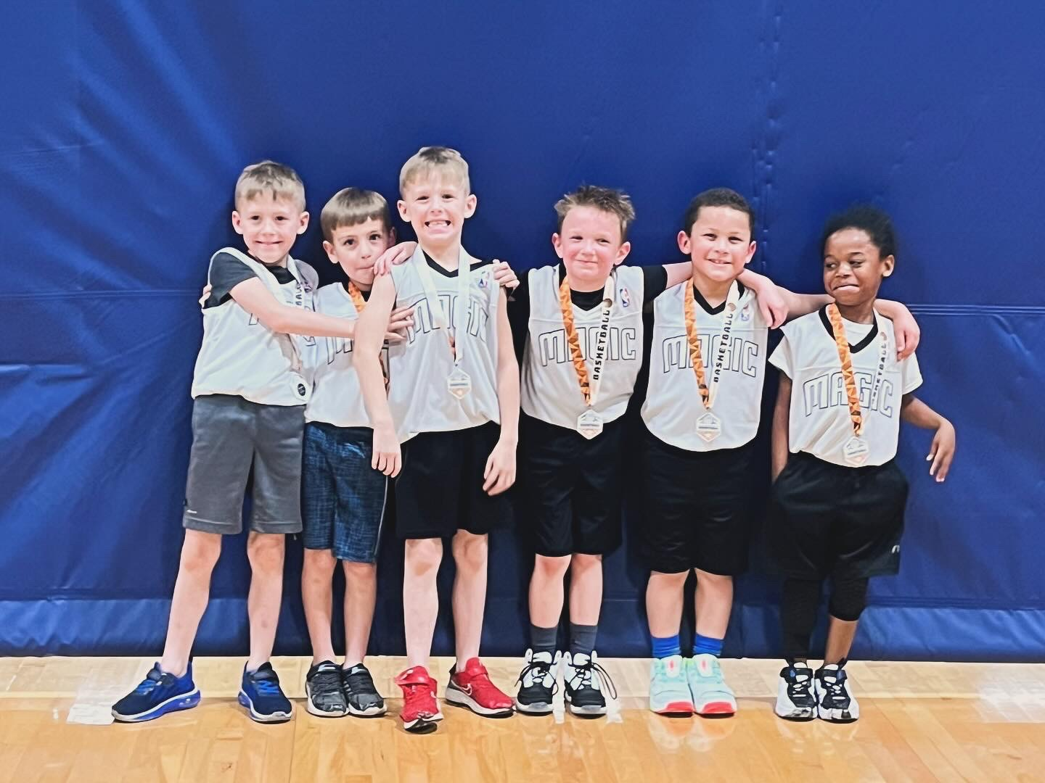

Slide 26
Practices
  Head Coaches make reservations under their name.
  Beginning Fri. Sept. 27 at 9:00 AM, call the front desk staff at 573-634-6482.
  Best if call Mon-Fri. 9-4 & speak to full-time staff, Luke, Jess, or LaTrise.
  To begin, only reserve pre-season practices from Sept. 27 to Oct. 26.
  In-season practices may be offered later.

Slide 27
Practices
  Free, but with limited availability, mostly on Fri. nights.
  Due to high demand, only 1 per week for 1 hour each.
  Each team should get 3-4 pre-season practices.
  5, 6, 7, & 8 PM on weeknights
  8 AM to close on weekends
    Sat. 6 PM, Sun 10 PM

Slide 28
Practices
  Grades K-1 half-court. 2-4 full-court.
  Before practice, our Facility Supervisor will lower the goals to the height for your grade.
  We will not provide basketballs, so ask the players to bring their own.
  We must keep 1 court open at all times for Lincoln Univ. students & Linc members.
  Free to practice elsewhere if have access to a gym.

Slide 29
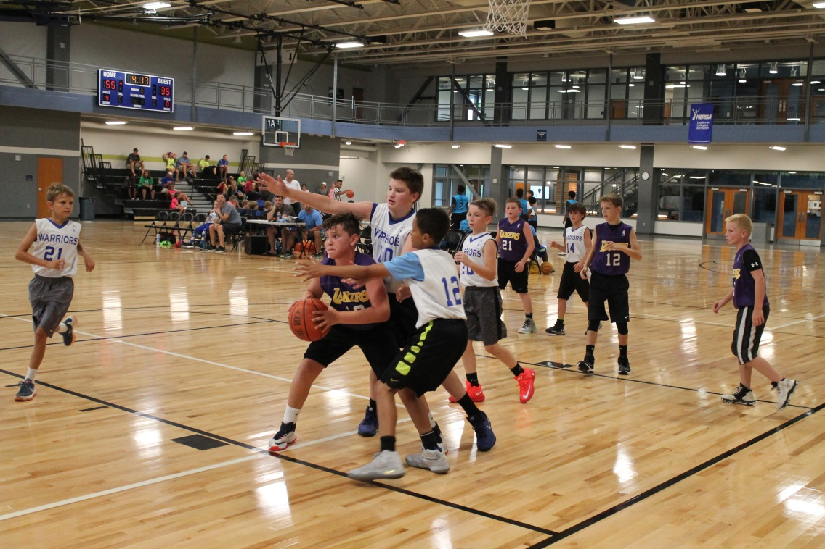
League Rules
  On the league website.
  Be very familiar with your grade/division.

Slide 30
Scores/Standings & Awards
Score & standings:
  NOT kept for grades K-1.
  Kept for grades 2-4.
All players receive an award (medal) at the end.
I will notify you when the awards come.
You pick them up at the front desk of The Linc and hand them out after your last game.

Slide 31
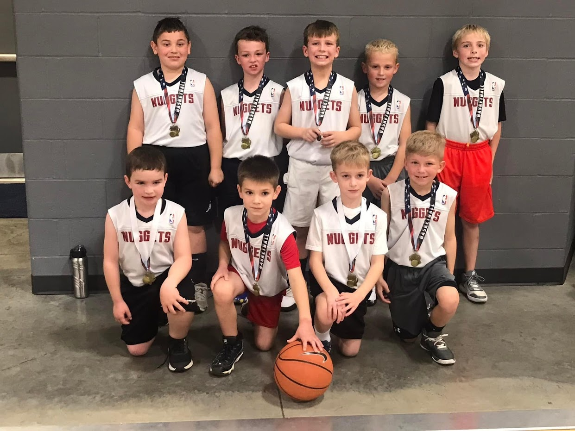

Slide 32
Volunteer Scorekeepers
Grades K-1:
  No score so a volunteer is not needed.
  Coaches start the clock and let it run until time expires for each quarter.
  Since half court and the clock shows the same for both sides (Court 1A & 1B), make sure all 4 teams are ready to begin.

Slide 33
Volunteer Scorekeepers
Grades 2-4:
  Each team needs 1 volunteer.
  1 volunteer to complete the scoresheet and 1 to run the clock.
  Make sure your volunteer records the final score.
  Simple directions on how to run the scoreboard are on the score table.

Slide 34
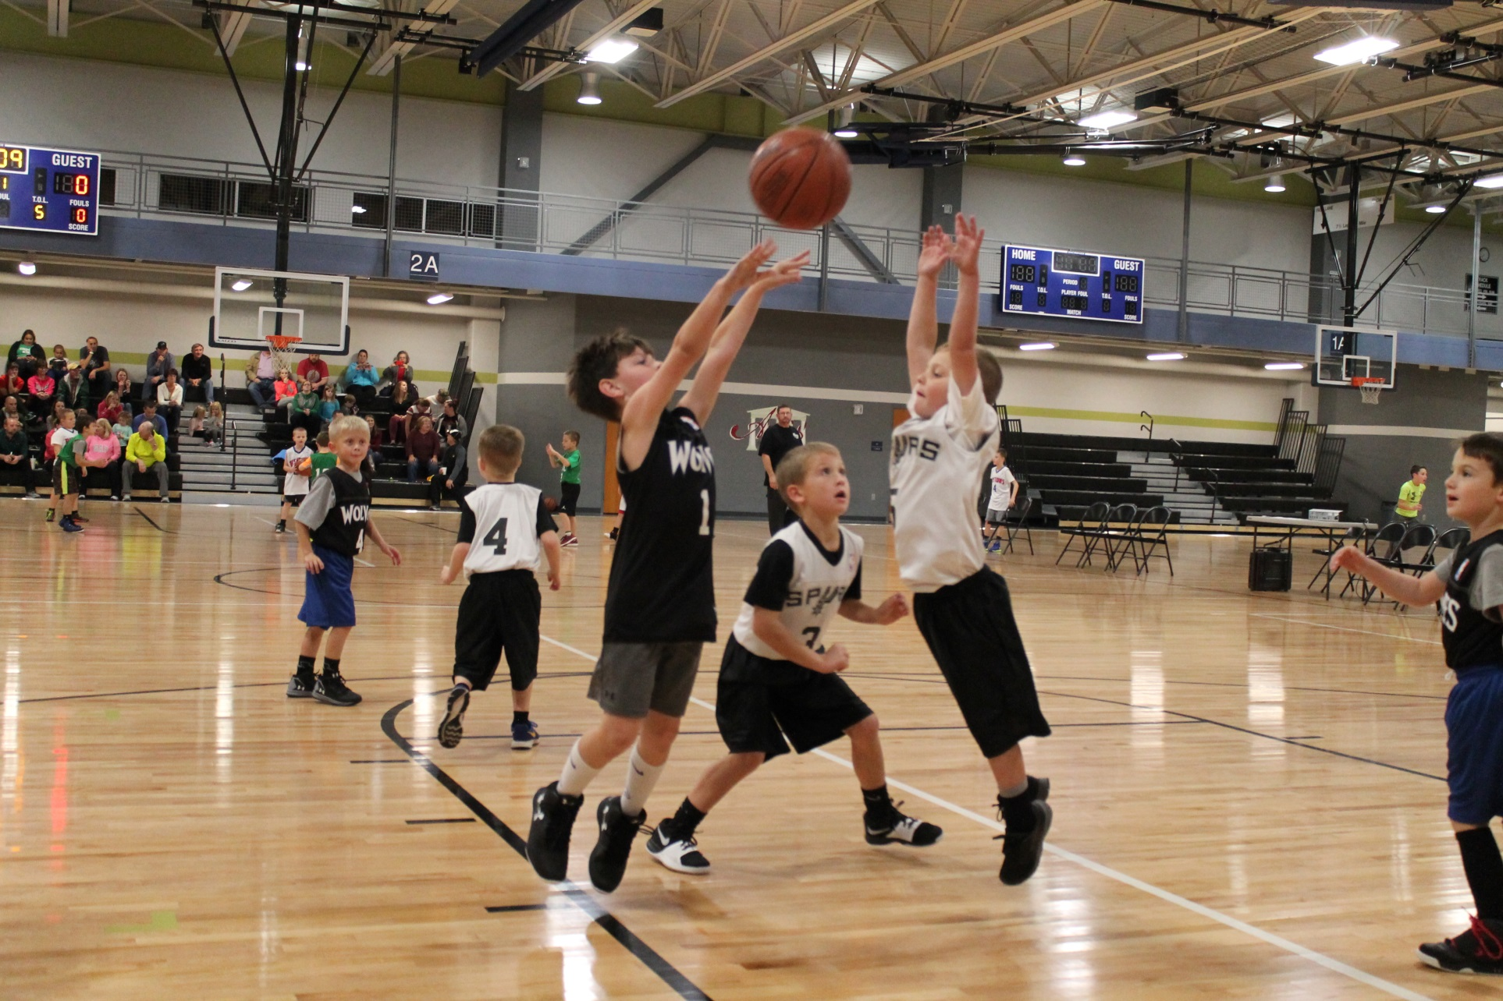

Slide 35
Team Equipment
  We will provide a few basketballs to each court for warm-up and game ball.
    Placed under the score table in a mesh bag.
    Make sure all basketballs are returned to the bag after each game.

Slide 36
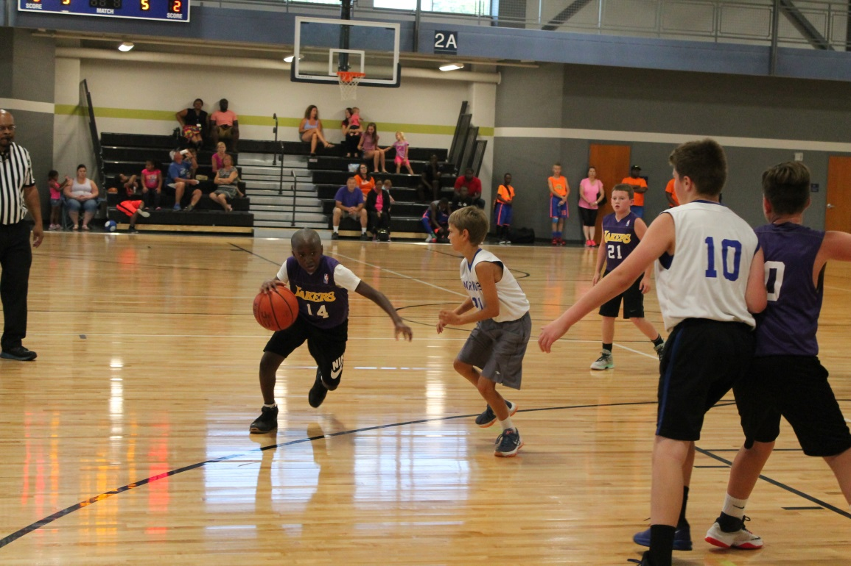
Jewelry
  For player safety, jewelry (ear rings, necklaces, bracelets, etc.) are not allowed while playing.

Slide 37
Jerseys
NBA-replica jersey corresponds to team name.
Reversible.
  Home team wears light side out.
  Away team wears dark side out.
Must be tucked in at all times.
I will let you know when the jerseys arrive so you can pick them up at The Linc.
Coaches do not receive a coach’s shirt, sorry.

Slide 38
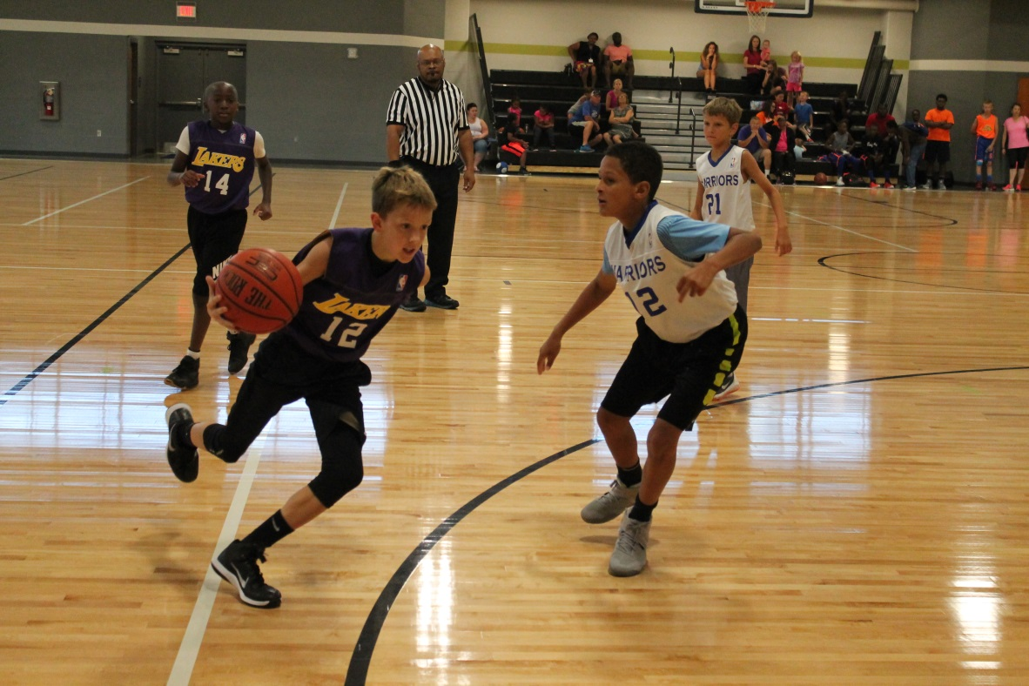
Sportsmanship
Everyone must always use good sportsmanship and conduct themselves in a professional and respectful manner.
This includes all coaches, players, parents, and fans.
Head Coaches are responsible for the behavior of everyone associated with their team.

Slide 39
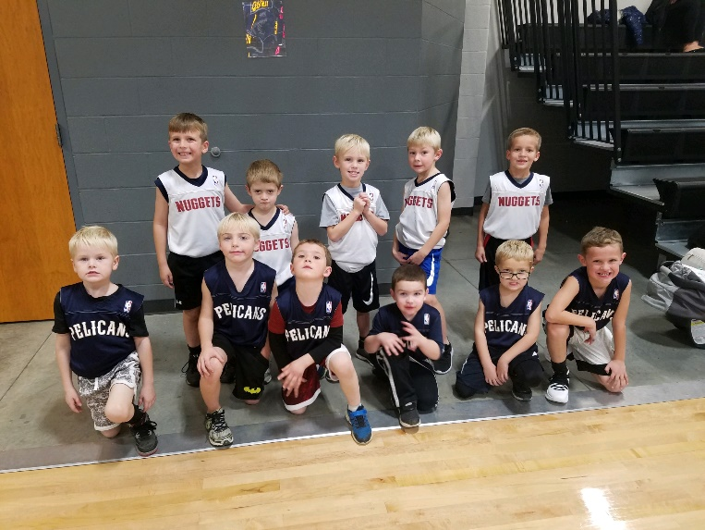
Sportsmanship
  We have a zero-tolerance policy and will not tolerate bad sportsmanship.
  Consequences will include ejections, suspensions, removal from the league and any means necessary.

Slide 40
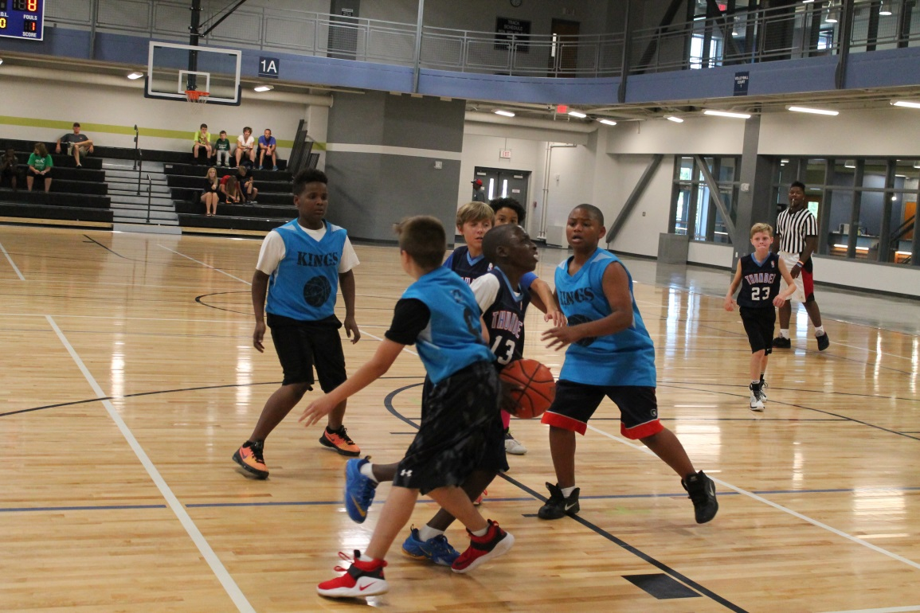
Sportsmanship
  Respect your opponent and do not run up the score.
  Sub different kids at various positions to help keep the score more competitive when needed.

Slide 41
Playing Time
Equal playing time is required in this league.
Plan playing time before the game begins
Have it on a sheet for reference during the game.

Slide 42
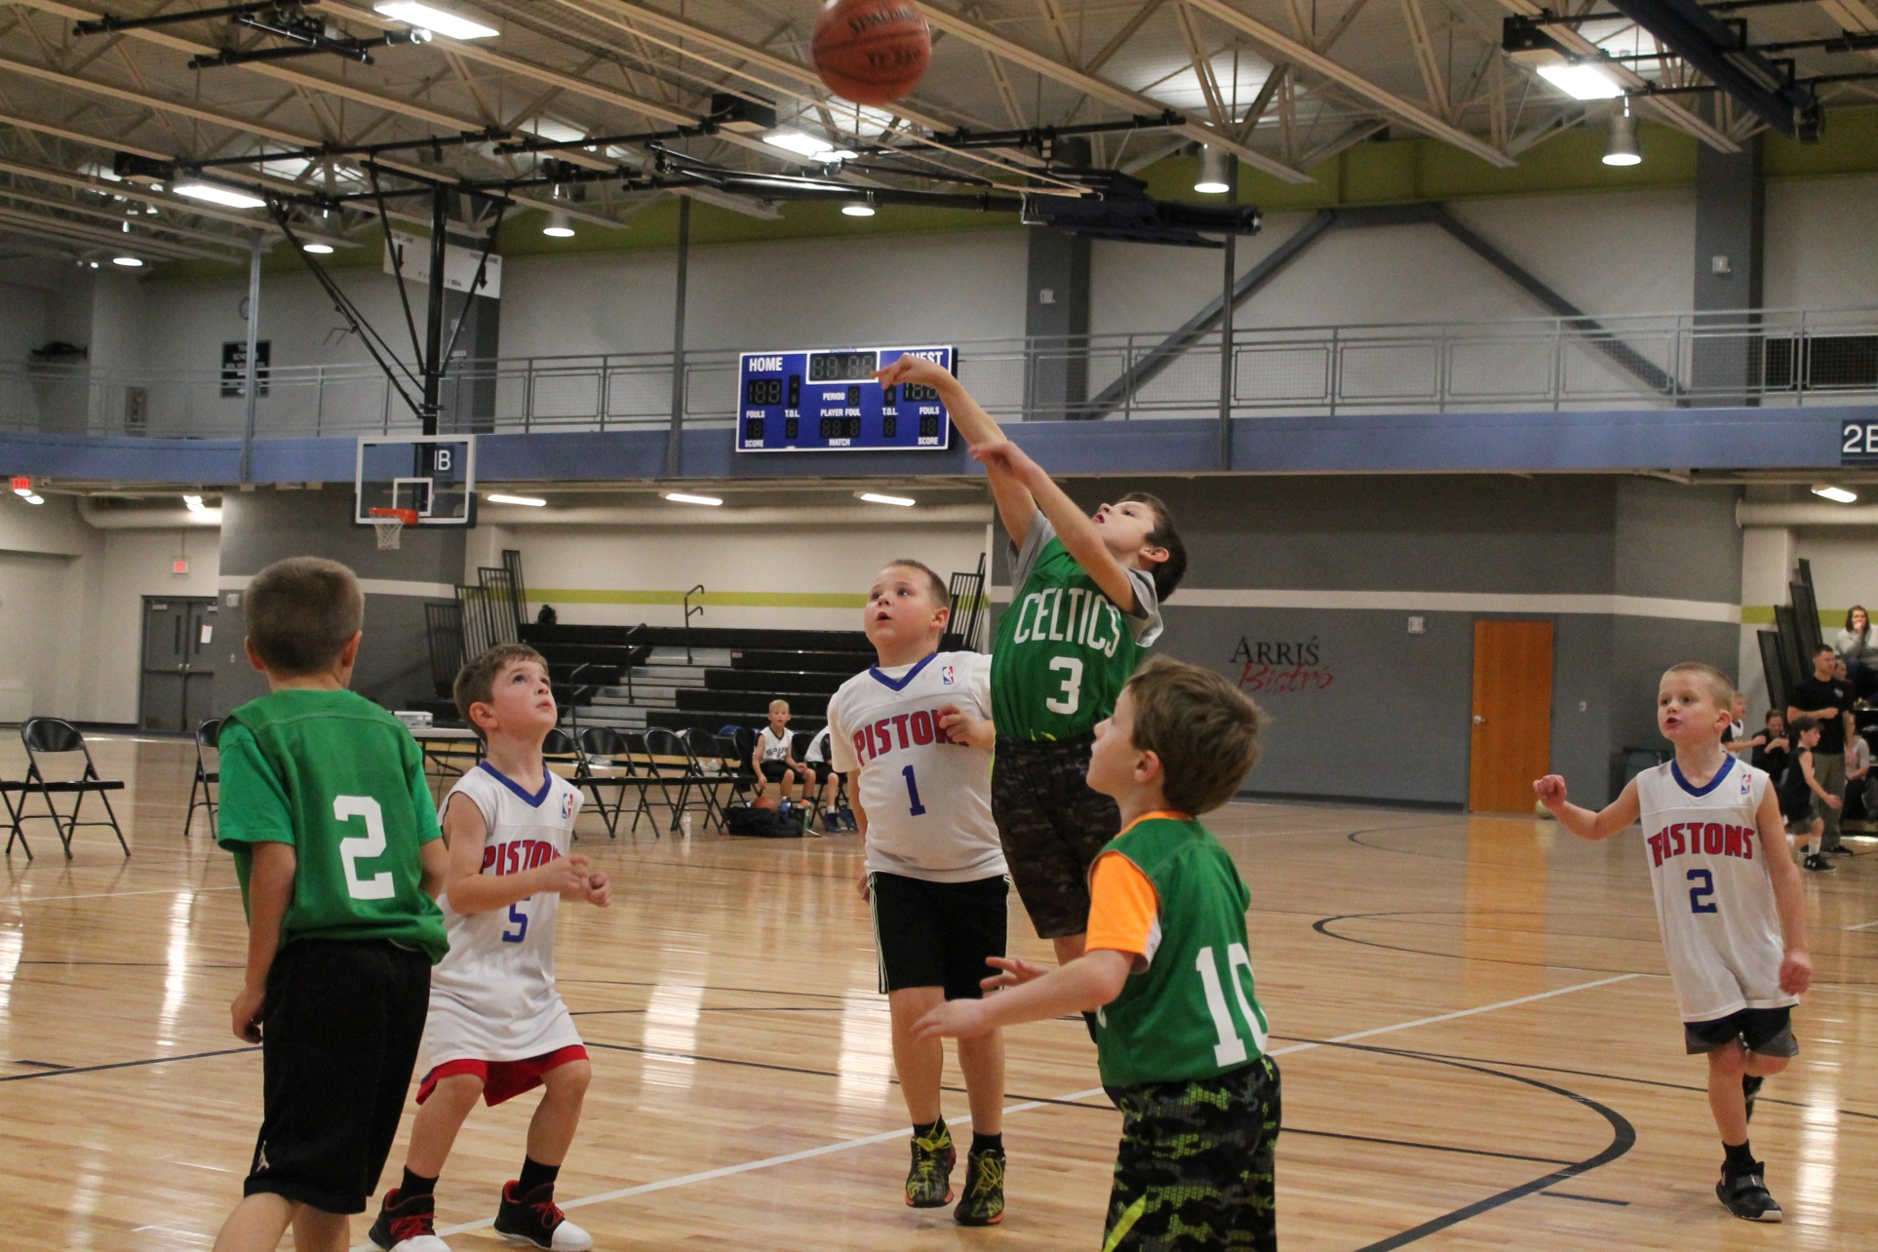

Slide 43
Officials/Supervisors
Officials:
  Grades K-1, the coaches are the officials.
    Please bring a whistle and enforce the rules.
  Grades 2-4, we will provide 2 for each game.
Facility Supervisors:
  On site wearing bright-colored shirts.
  If you need assistance, please ask.
  Report all emergencies, accidents, incidents, etc. to them ASAP.
Please be considerate and respectful.

Slide 44
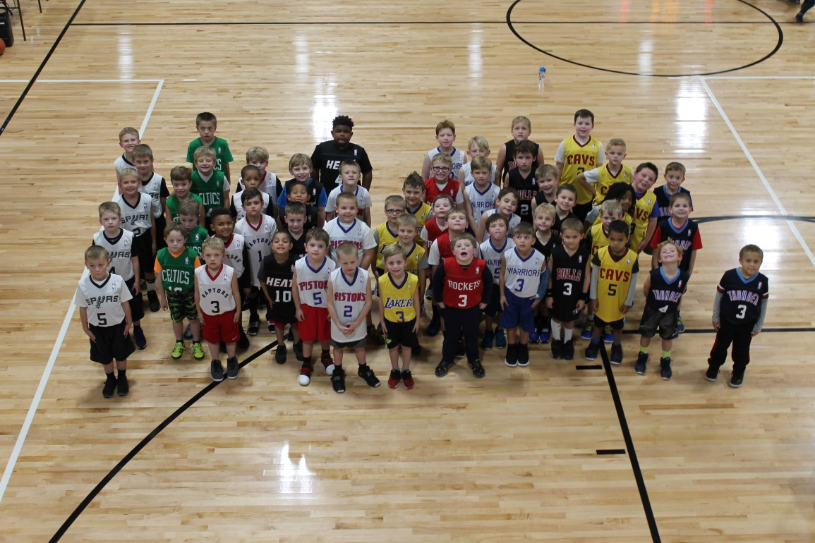

Slide 45
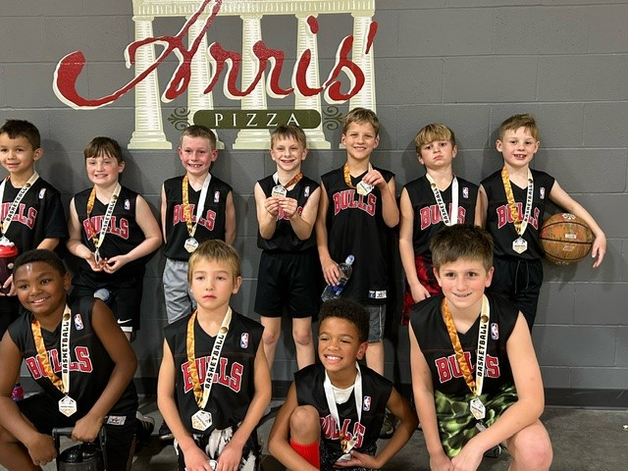
Survey
End of each season, I email a brief online survey to all coaches and parents.
Please take the time to offer us constructive feedback so we can continue to improve.

Slide 46
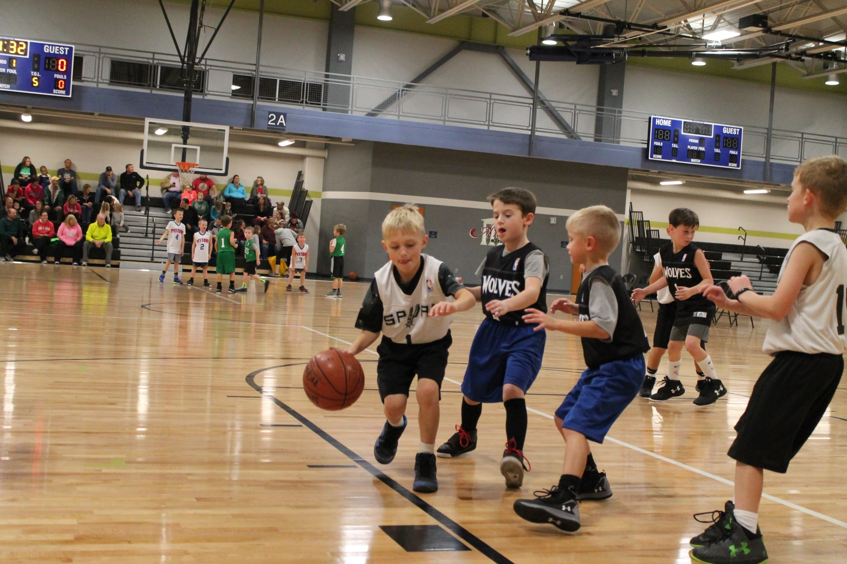
Questions?

Slide 47

Thanks again!
Thanks again for coaching and for your time and effort as we all work together to provide a safe, fun, and enjoyable youth sports experience for the kids in our community

